Slide 1

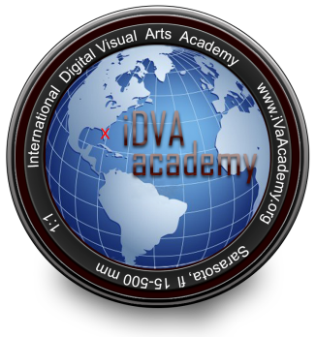


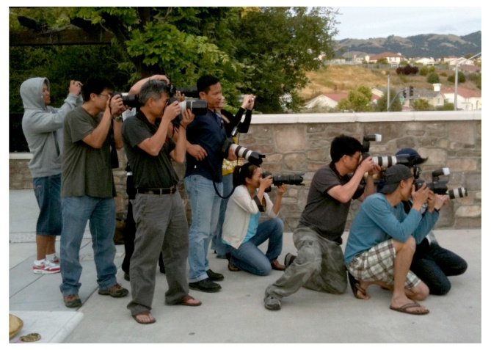
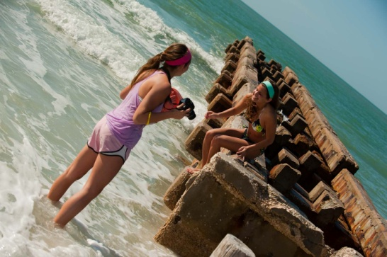


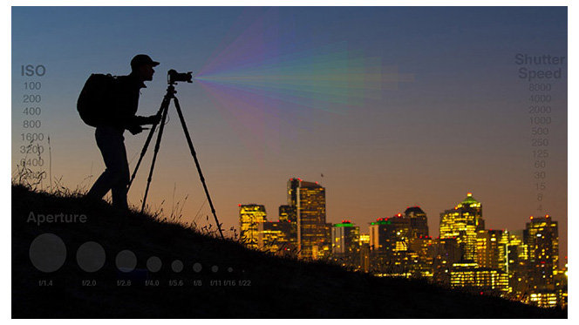
Movie Video Production
iDVAacademy.org
Creating Pixel Pigment with your Imagination!!
“SUCCESS”………WHEN PREPARATION MEETS OPPORTUNITY
Our student Digital Visual Artists have the edge by combining Professional and Master Instruction
with the opportunity to be educated at one of the premier artistic destinations in the world.
An exciting environment that gives ‘the edge up’ to the Digital Photographer’s development

Slide 2
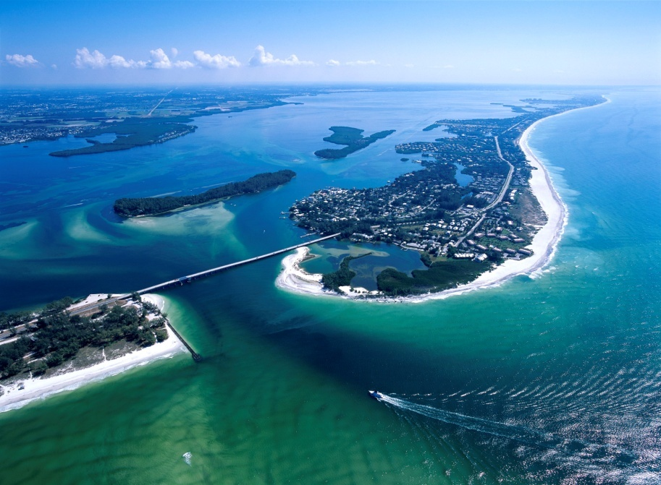

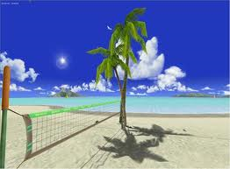
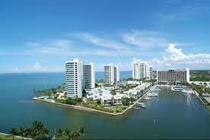
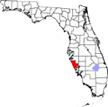
Movie Video Production
We are excited that you are considering joining our Academy
for developing your skills to the highest level
for college and professional advancement.
Steve Stennes
President, iDVA Academy
Welcome!
iDVAacademy.org
With America's best beach, arts & culture, attractions,
sports and more, Sarasota offers something for everyone.
In short there is no better place for your child to
pursue their artistic, sport and academic dreams!
Located on the West Coast of Florida, boasting beautiful weather
year-round, breath-taking beaches, excellent communities and
accessibility via three international airports, Sarasota is one of the
most desired destinations in the world to live, learn, vacation,
work and raise a family.
While maintaining a small town atmosphere, Sarasota has a big city feel with exceptional
amenities, offering some of the finest museums, art and antique galleries as well as one of
a kind shops and boutiques. In addition you can enjoy world class ballet, plays and opera;
comedy, symphony and jazz clubs, sporting events and exceptional dining.

Slide 3

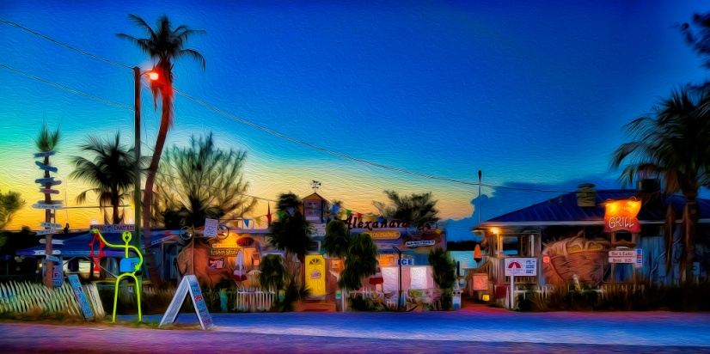
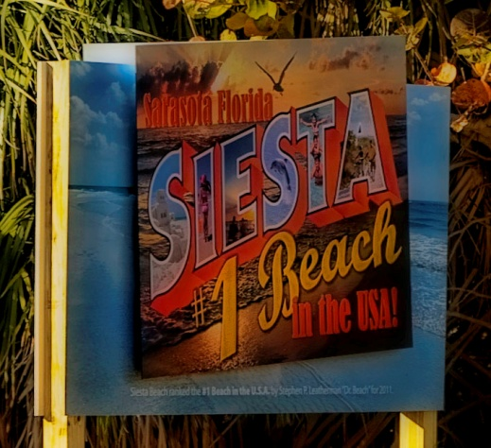
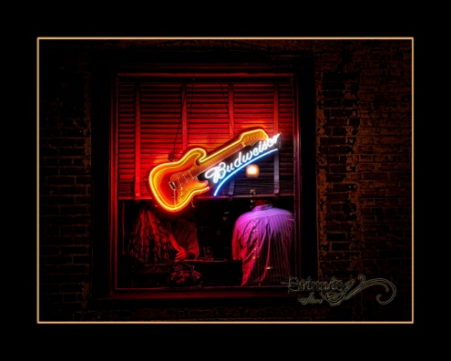
Movie Video Production
Digital Visual Arts
iDVAacademy.org
At iDVA academy you will learn to capture the important moments in life, produce them digitally with precision and emotion to tell your story. Today's Movie Video Production Arts are fast paced environments of constantly evolving technologies mixed with the art of creative storytelling.
Today's digital visual artist needs to have a solid base in the digital world along with a solid base in the physical world and be able to bring that knowledge together with their passion and vision of life to create the sought after uniquely expressed images of today.
We will teach the technical aspects of using all forms of digital tools so they become an extension of your finger tips to capture your mind’s vision. We will teach students how to work with their vision in a way that helps them bring what they see and experience to life.
Creating From Your Minds Eye!!

Slide 4



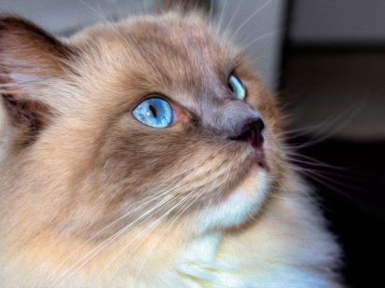
Movie Video Production
Your Future
iDVAacademy.org
Our world is changing:
“Our world is moving from an economy/society built on the logical, linear capabilities of the Informative Age to an economy/society built on the inventive, emphatic, big-picture capabilities of the Conceptual Age”. (Excerpt from “A Whole New Mind-Why Right-Brainers Will Rule the Future” by Daniel Pink)
According to Sarasota’s own internationally acclaimed Ringling College of Art and Design, creative oriented jobs have increased from 10% to 30% of the economy; that “The future belongs to visual communicators”. Each year, they host recruiters from Disney, Pixar, Hallmark, Target, DreamWorks, Sony, and Apple. And each year, a host of Ringling students are offered internships. Many go on to pursue careers with the same companies. www.ringling.edu
“The arts develop skills and habits of mind that are important for workers in the new economy of ideas”
– Alan Greenspan, former U.S. Federal Reserve Chairman.
Creating From Your Minds Eye!!

Slide 5
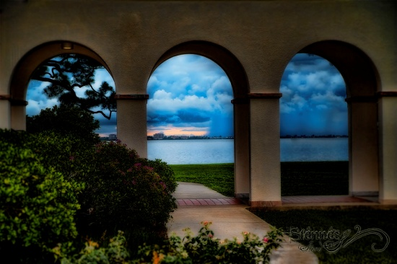
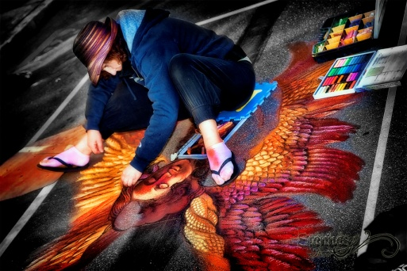
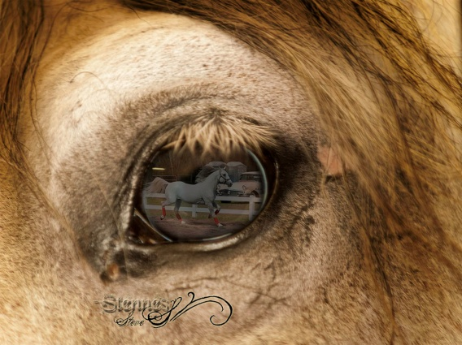

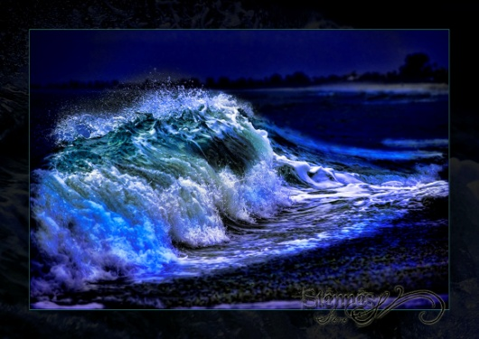



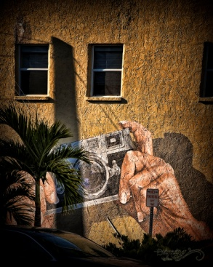

Movie Video Production
Prepare!
iDVAacademy.org
New innovations, breakthrough technologies, and changing consumer habits are redefining the media fueling
demand for media professionals who can apply the latest tools and techniques to create compelling digital content.
In a field where the only constant is change, employers are on the lookout for communications and media professionals
who are familiar with the latest digital techniques and tools. While employment is projected to grow at an average
pace, demand for digital artists
increase!
(Northern University, College of Professional Studies)
Creating From Your Minds Eye!!

Slide 6


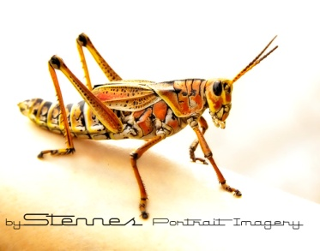
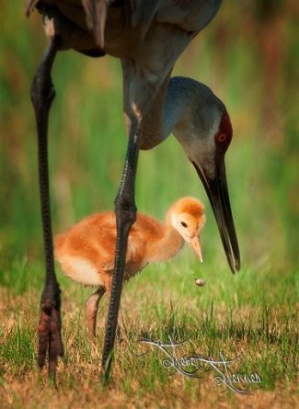

Movie Video Production
Technical Training
iDVAacademy.org
Movie Video Production:
Photography-in-motion, Can you say Hollywood! Gain competency in digital production and post-production while exploring various formal, conceptual, & structural strategies. Learn to generate digital video that communicates effectively and inventively, in preparation for positions in the creative industries of gaming, design, and media production. For example: Commercial, Informative, Webinar, Podcast, public service announcement (PSAs), Culture, Testimonials and Animation.
Creating From Your Minds Eye!!

Slide 7
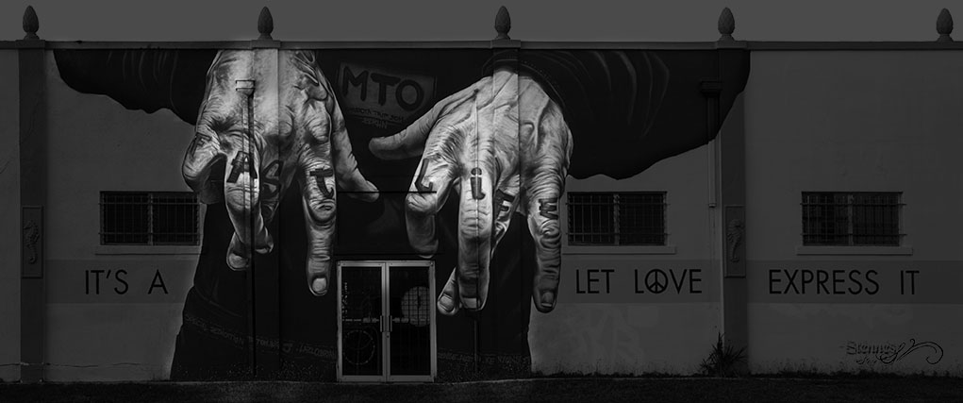

Movie Video Production
Technical Training
iDVAacademy.org
  Additional training will include:
  Website Design:
  Focuses on the dynamics of communication in the digital world.
  Learn to communicate effectively in website medium using tools like Adobe Muse® and Dreamweaver® in all organizational contexts.
Interactive Design:
Offers an overview of courses in the creative process of storytelling and communicating through visuals and sound.
Gain expertise in time-based design, interface, and experience design through a practice-oriented problem solving
approach.
  Group Communications:
  Focuses on the dynamics of communication in complex groups and organizations, for the purpose of learning how
  individuals within such groups and organizations can become effective communicators.
Creating From Your Minds Eye!!

Slide 8



Movie Video Production
Technical Understanding of Digitizing Light
iDVAacademy.org
Technical Skills:
Learn and develop the technologies & technical skills needed to master Movie Video Production arts.
Perfect exposure through the use of camera settings, ISO, Shutter speed and Aperture.
Light sensor & metering, lens & optical glass technologies.
Shutter speed to subject/camera motion relationship.
Aperture settings and their relationship with depth of field and focal length.
Focus metering systems, subject tracking and face recognition technologies.
Mastering light, understanding the characteristics of available and artificial light.
Computer Skills:
Digital file and raw sensor data technologies as well as storage and transfer.
Image processing and manipulation technologies using the latest professional software
such as Adobe Premiere®, adobe after effects®, Adobe Fireworks® and Adobe audition®.
Workflow skills, how to arrange your work flow to maximize productivity.

Slide 9

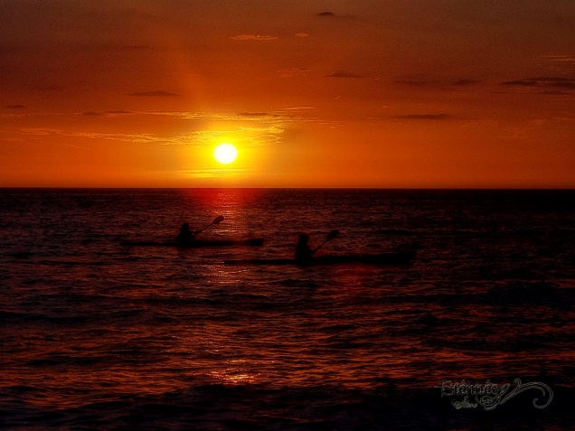
Movie Video Production
Artistic Understanding of Digitizing Light
iDVAacademy.org
Artistic Skills:
Mastering light, how to create and manipulate light to achieve a desired effect.
Transforming your life passion and emotion into the image creation process.
Learning to see the story through visual impact and how to capture it.
Session preparation both with tools and mental readiness.
Honing visual skills, improve ability to predict what will happen next.
Studying subject movements and emotion.
Focusing on your subject and tuning out distractions.
People skills and gaining trust through confidence and politeness.
Artistic visual skills, composition, color relationship, contrast etc.
Collaborate with other artist to create new looks and medium assemblies.
Creating From Your Minds Eye!!

Slide 10
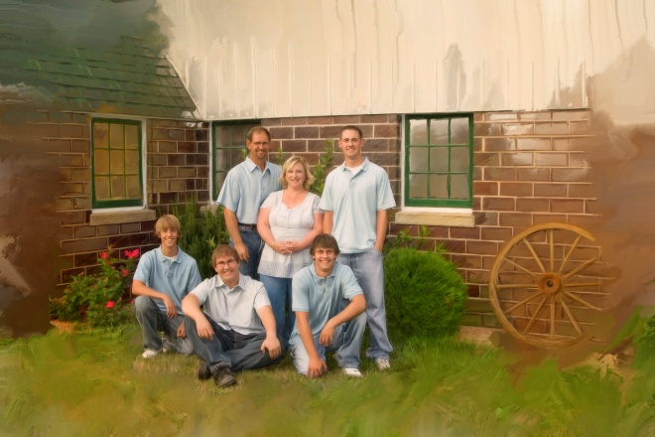

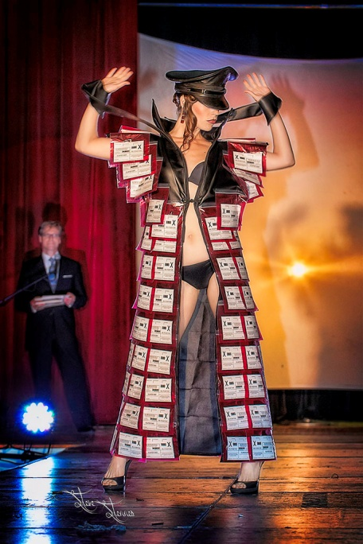


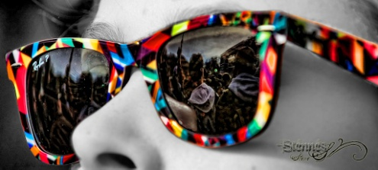
Movie Video Production
Competition
iDVAacademy.org
Competition Skills:
Competing in local and international video competitions.
Learning the 12 elements of a meriting visual art and be able to judge what qualifies as
outstanding digital visual art.
Create professional looking portfolios of your work and how to present them on the web.

Slide 11



Movie Video Production
Training
iDVAacademy.org
Quality Instruction:
iDVA academy students are instructed by Master Photographer and Digital Artist, Steve Stennes, and staff who have taught students to win competitions at the highest levels like National Geographic, TCPPA and PPA Professional Associations. We teach the students to understand all the technical elements and technologies to create the highest quality images possible with today's digital equipment.
Real World Experience:
Regular real world outings will give students a chance to develop their skills in the heat of the moment sessions preparing them with experience needed to succeed in today's demanding Movie Video Arts field. Aside from studio and outdoor field trips, all students will attend and video at many of our other academies and sporting events to gain real life experience.
Professional Photographer’s of America
Creating From Your Minds Eye!!

Slide 12

Movie Video Production
About the Master Photographer & Digital Artist
iDVAacademy.org
It was fortunate for Steve Stennes to find his career path at a very young age. In fact, he began his Visual Arts experience in grade school; he was in love with image-making and painting with various mediums. Upon graduating high school he was already an accomplished artist with a gift for composition, emotion and an artistic view.
Steve continued to study visual arts over the years as he worked on his computer science degree and digital animation graphics. When that training was complete, he opened his own studio and the camera along with digital technology became his medium of choice.
Steve continued to study under noted Master Photographers and Videographers of the time. Steve schooled with the (PPA) Professional Photographer of America for 4 years. Steve was able to capitalize on his artistic talents and computer skills to launch him into the new Digital Visual Arts world as it was evolving. In 2003, Steve was awarded ‘Wedding Photographer of the Year’ by The Pros Entertainment Services Inc. winning over 350 of the East Coast’s best image makers. In 2007 and 2008, Steve again competed and was awarded ‘Portrait Photographer of the Year’ by the (TCPP) Twin Cities (Minnesota) Professional Photographers Association. Steve has had prints receive National Merits, accepted into loan collections and published on the cover of nationally syndicated magazines. He has also been the technical advisor producing video commercials for large service organizations and has created digital animations for commercials.
After successfully running a portrait and event studio for years, Steve began teaching and soon realized this was where he truly belonged, sharing his knowledge and artistic talents with others. He has been teaching photographic art and digital manipulation with Photoshop® since then in several settings including his studio, Community Education classes, one-on-one and currently at the Art Center Sarasota.
Steve offers one-on-one training as well as group courses covering every aspect from capture to print and
digital visual display, Adobe Photoshop®, Premier®, After Effects®, Dreamweaver®, Muse® FireWorks®, and Poser® usage and
techniques, from beginner to advanced. Steve has helped several other professional digital visual artists advance
their skills and studio productivity.
In 2013, he started the International Digital Visual Arts Academy, LLC to pass on his love for the
Digital Visual Arts to emerging students.
Please be assured of his dedication and absolute commitment to excellence.
Creating From Your Minds Eye!!

Slide 13

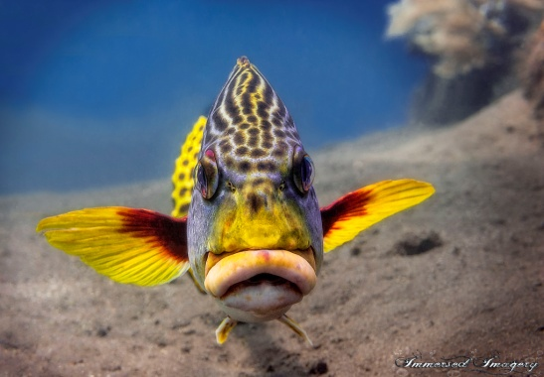
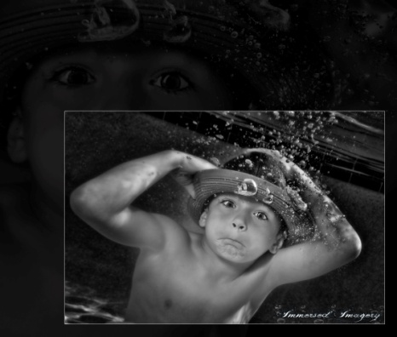
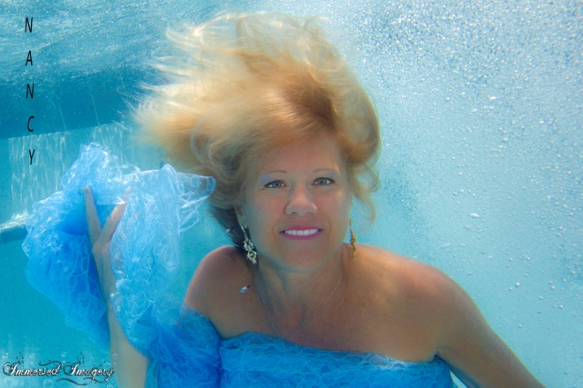
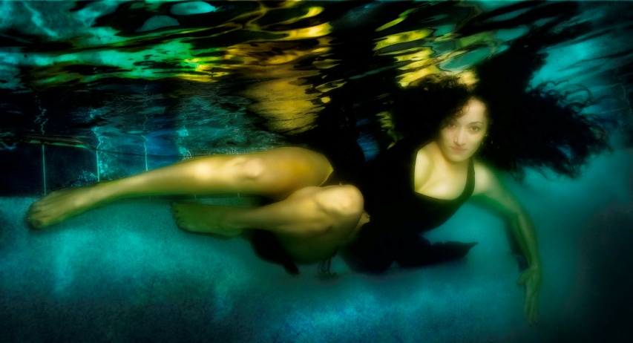

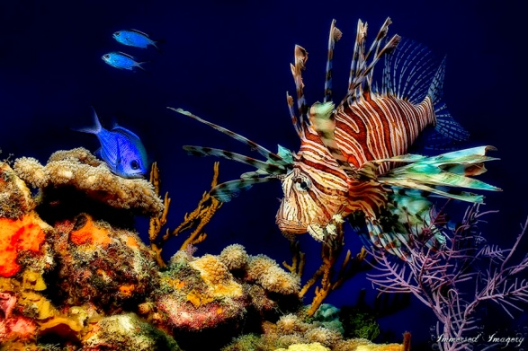
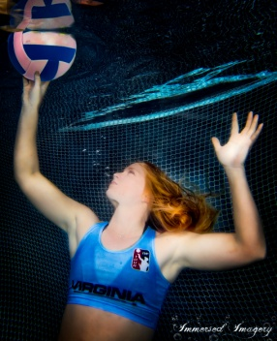
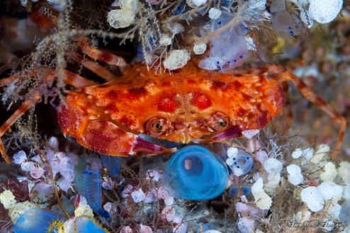
Movie Video Production
Nancy Knight, Instructor
iDVAacademy.org
Nancy’s passion for photography blossomed when she was certified in scuba diving in 1989. She just had to capture the beauty below the seas! Eventually she took her talents and returned to land and all other types of photography. One of her current passions combines the two and became Underwater Portraiture. This exciting new medium puts people in everyday life beneath the water creating effects found no where else!
Creating From Your Minds Eye!!

Slide 14


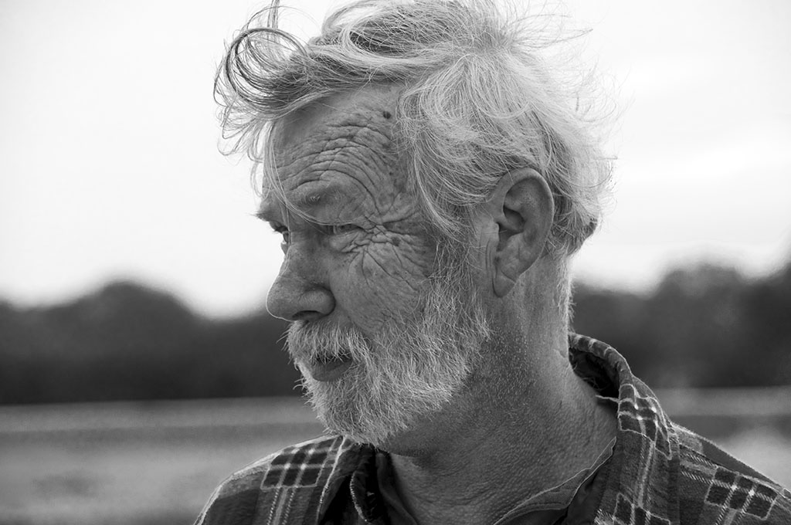
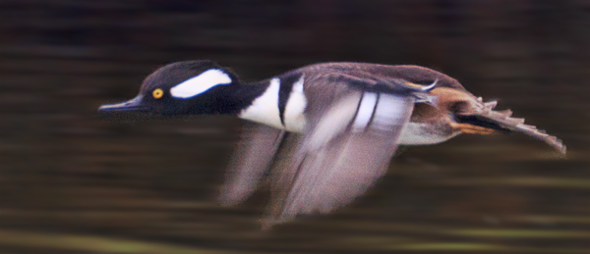

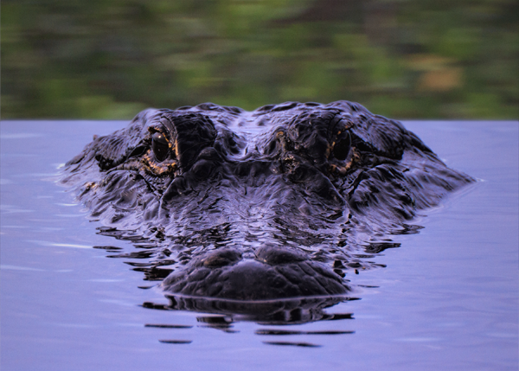
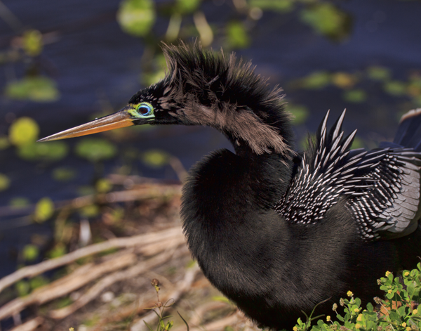
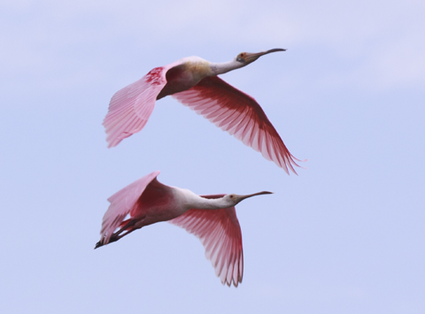
Movie Video Production
Bud Janney, Instructor
As a Graphic Designer for the past 40 years, Bud needed to
have control over the images in his design work. From product
photography to architectural work to events and portraits, Bud has
relied on his own capturing of images to make his design-work exactly match his demands. Since relocating to Florida 12 yrs ago, Bud has expanded his photographic horizons to fulfill his own personal interests as well, namely nature. Pairing the natural paradise of Florida with his keen sense of style, balance and “eye” for framing a scene, along with 30+ years of image manipulation with Photoshop® he is a great resource to our program.
iDVAacademy.org
Creating From Your Minds Eye!!

Slide 15
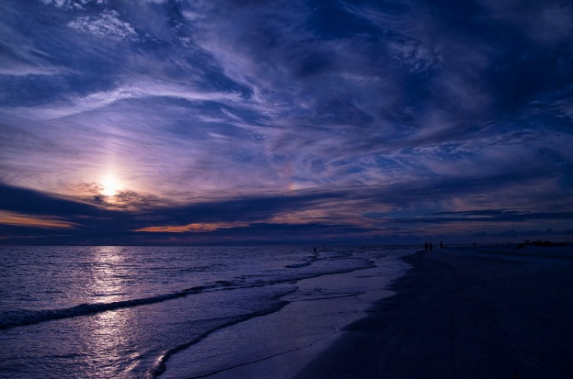
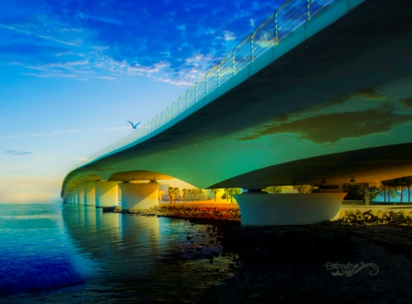

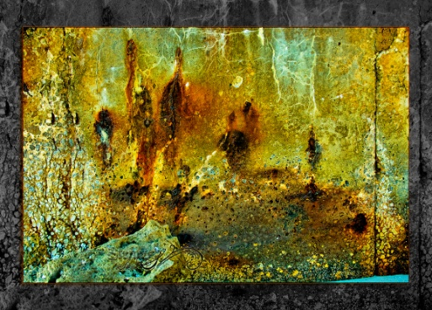
Movie Video Production
Weekly Study Format (Example)
iDVAacademy.org
Monday | Tuesday | Wednesday | Thursday | Friday | Weekends
Critiquing Q&A | Capture lesson and hands on | Capture lesson and hands on | Capture lesson and hands on | Elective Day On-location sessions | Occasional On-location Sessions and Competition
Editing footage | Post Capture Computer study | Competition Computer study | Post Capture Computer study | Q&A
Creating From Your Minds Eye!!

Slide 16
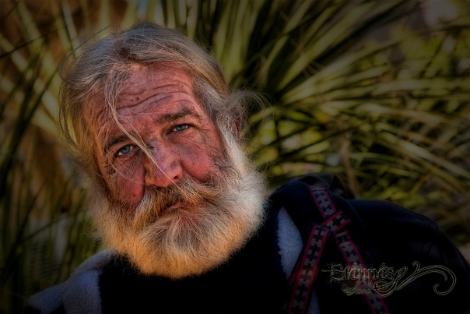

Movie Video Production
Post Graduate Program & Camps
iDVAacademy.org
Post-Graduate Program:
Colleges fully recognize the value of students enrolling after a Post Grad experience. With a growing demand and need for
such a specialized offering. Many graduating seniors today are not ready technically and/or competitively to excel at their
desired level of college arts. Likewise, some student artists are searching for a year where they can live independently and
better prepare for the rigors of college life. And there may be academic reasons why taking an extra year between high
school and college is the best course of action (i.e., SAT/ACT issues, ESL or TOEFL issues, GPA problems, the chance to take
college credits in advance, etc.).
The iDVA academy 7 month post-graduate program is for the digital photography student who needs an extra year of digital
photography training and/or academics to expand their college recruitment opportunities. This program offers academic
options to meet each individuals needs for college preparation including: SAT/ACT prep course, credit recovery
classes and on-line college courses, including college placement strategies.
Summer and Holiday Camps:
iDVA academy offers coed, summer boarding and day camps for the novice to elite level. All iDVA camps parallel the
boarding Academy program, and focus on technical, artist, applied practices aspects of the art for the optimal
performance edge. These camps bring college scouts from around the country to see the top talent for future enrollment.
“Our focus is on your future.”

Slide 17

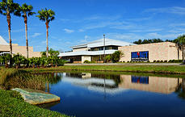
Movie Video Production
About Our Academy
iDVAacademy.org
Our academy:
Provides a unique opportunity for the Digital Photography student to be immersed into an environment of elite training accompanied by top of the line academics, provided by Elevation Preparatory Academy (EPA). With a diverse student body, small class size and excellent facilities our students are prepared not only to be competitive in their field but also inspired to reach their full academic potential. We focus on the total student, so that he or she can begin their collegiate career with the right mindset and skills.
For international students, Elevation Preparatory Academy completes the I-20 form allowing them to receive an F1 Student Visa to attend EPA.
“Our focus is on your future.”

Slide 18


Movie Video Production
Middle & High School – Fast Facts
iDVAacademy.org
Elevation Preparatory Academy
582 McIntosh Road
Sarasota, FL 34232
www.elevationprep.org
Grade Levels: Middle School through 12th grade
Post graduate: Photographic Arts
Full time 9 month programs
Co-educational College Preparatory –
Independent Private School
Average Class Size: 10-15
Percent International Enrollment: 85%
Foreign Countries Represented: 32
“Our focus is on your future.”

Slide 19


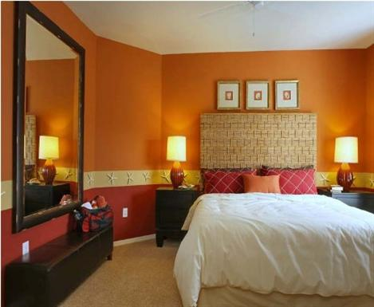


Movie Video Production
Student Boarding
iDVAacademy.org
Student boarding is available but not mandatory. Those who choose to board with us will live at nearby apartment style lodging. Staff members living in the apartments are responsible for their security, health, and well-being 24 hours a day.
In overseeing daily life in the apartments, they keep the students on schedule for school and account for their whereabouts while at EPA. They also coordinate the student’s needs with staff and parents.
Meals: Three nutritious meals are provided daily to all boarding students.

Slide 20
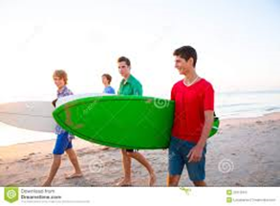


Movie Video Production
Student Life
iDVAacademy.org
It is our mission to ensure every student has a positive experience on and off the campus. We encourage all students to enrich their own level of personal growth through diverse experiences, training, nutritional counseling, community involvement and fun activities.
We feel it is important to provide a balanced life for our students. Off-campus field trips with fellow students to local malls, movies and outdoor games encourage social skills and interaction.
Outside of training and recreational activities, our students are encouraged to participate in extracurricular activities to develop teamwork, leadership and problem solving skills.
“Our focus is on your future.”

Slide 21

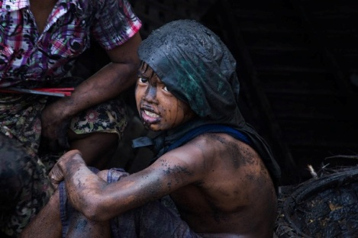

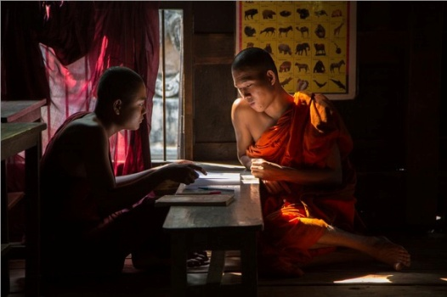


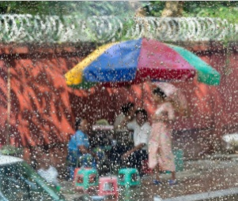
Movie Video Production
The Mission of the International Digital Visual Arts Academy is to empower our students to be creative, respectful, leaders in their arts and who value personal integrity and get involved with life...
iDVAacademy.org
Our students are prepared not only to be competitive in their Digital Photography Art but also to be inspired to reach their full academic potential. We focus on the total Student-Artist, so that he or she can begin their collegiate career with the right mindset and skills. Post-graduate classes are also available.
Our teachers will work tirelessly to promote and market our students to create as many opportunities as possible to succeed in college. We will work with each student to create an individual specific college placement strategy that will maximize their exposure to college digital visual arts. Our approach to recruiting is efficient and effective.
Photos of student success stories:
Jeannine Mullan-National Geographic “Myanmar”
Kayne Torman
Ken Kephart
Angela Murphy
Charmaine Frost
“Our focus is on your future.”

Slide 22
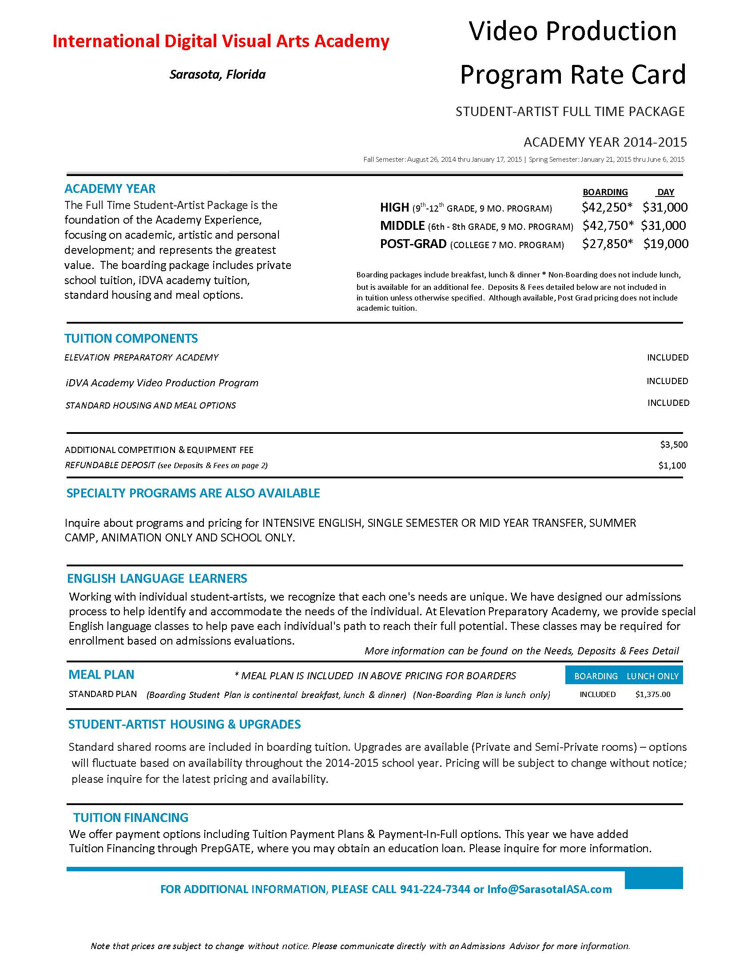
Movie Video Production
Rate Card
iDVAacademy.org

Slide 23
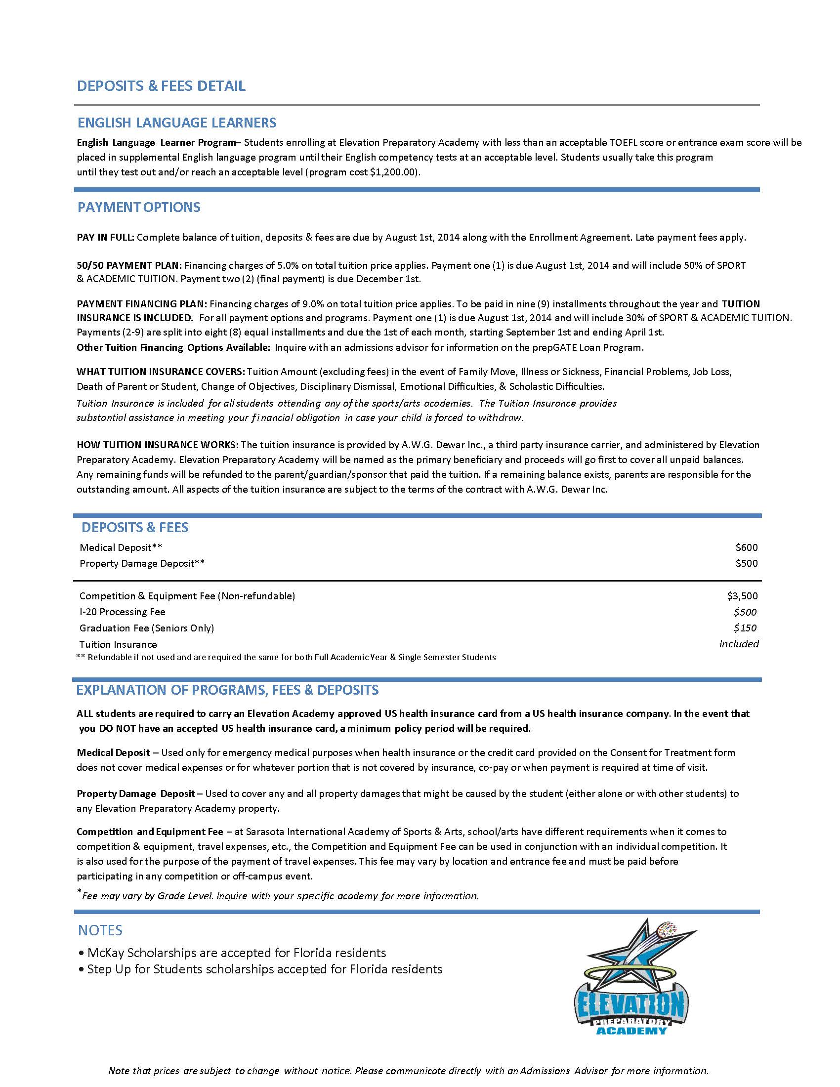
Movie Video Production
Rate Card
iDVAacademy.org

Slide 24
Movie Video Production
Final Note…
iDVAacademy.org
Hi,
I want to take this opportunity to thank you for inquiring about our International Digital Visual Arts Academy in Sarasota, Florida.
As one of our students, you will enjoy the best indoor studio and on-location Digital Visual Arts training with myself and our locally acclaimed instructors. College scholarships for Digital Visual Arts are at an all time high and our training will help you to be seen by the best colleges in the country. That’s why we train you in all aspects of the Digital Visual Arts.
If I can answer any questions or concerns, please contact me personally so we can turn your digital passions into a reality.
Thank you,
Steve Stennes
President
iDVAa–International Digital Visual Arts Academy
Steve@iDVAacademy.org
941-544-5704
*All images and content are copyrighted by: iDVA academy, LLC & Immersed Imagery, LLC and/or the original artist*
"The mature artist has control over all elements of his work.
This is where creative freedom and authority become evident
in his work.“

Slide 25

Movie Video Production
25 FAQ’s
iDVAacademy.org
1. What is International Digital Visual Arts Academy's Digital Video Program?
A world-class, Video Production Program for the serious young artist, who wishes to explore their passion and train hard to develop the skills necessary to pursue a future in the fun, creative and constantly evolving field of Video Production and Movie Making. Can you say ‘Hollywood’!!
Teaching:
Digital Video Production:
Photography-in-motion. Gain competency in digital production and post-production while exploring various formal, conceptual, & structural strategies. Learn to generate digital video that communicates effectively and inventively, in preparation for positions in the creative industries of movie making and video media production. For example: Commercial, Informative, Webinar, Podcast, Public Service Announcements (PSAs), Culture, Testimonials and Animation. As well as numerous other positions in the video making process like lighting, editing and special effects. (Software: Adobe Premier® and AfterEffects®)
Website Design:
Focuses on the dynamics of communication in the digital world.
Learn to communicate effectively in website medium using tools like Adobe Muse®, Dreamweaver®, Fireworks®, InDesign®, illustrator® in all organizational contexts.
Interactive Design:
Offers an overview of courses in the creative process of storytelling and communicating through visuals and sound. Gain expertise in time-based design, interface, and experience design through a practice-oriented problem solving approach.
Group Communications:
Focuses on the dynamics of communication in complex groups and organizations, for the purpose of learning how individuals within such groups and organizations can become effective communicators.

Slide 26
Movie Video Production
2. Who is Steve Stennes?
A 30+ year Master professional photographer/videographer and animation/Gaming designer who has won awards at all levels. Steve has been teaching photographic art and digital graphic arts for over 20 years.
3. What is an “International”?
Teaching students from all over the world and competing in competitions worldwide.
4. What professional associations has Steve been a part of?
PPA, Professional Photographers of America
TCPPA, Twin Cities Professional Photographers Association
MNPPA, Minnesota Professional Photographers Association
NAEA, National Arts Education Association
5. What Awards did Steve receive?
2003 Wedding Photographer of the year.
2007 Minnesota Twin-Cities Portrait Photographer of the year.
2008 Minnesota Twin-Cities Portrait Photographer of the year.
Steve has been awarded Merit awards at all levels from Local, State, Regional and National competitions.
These merits were needed to receive his Master status.
6. What kind of Digital Visual Arts programs does the iDVA academy offer?
A. A full-time Video Production program with boarding and academics
(9-month program from late August until the end of May)
B. A full-time non-boarding Video Production program with academics
(9-month program from late August until the end of May)
C. A full-time, non-boarding, local Video Production program without academics
(9-month program from late August until the end of May)
iDVAacademy.org

Slide 27
Movie Video Production
7. Do you offer a Post-Graduate program?
We offer a 7-month post-grad program for the Video Production student who needs an extra year of training and/or academics to expand their college recruitment opportunities. This program offers academic options to meet each individuals needs for college preparation including: SAT/ACT prep course, credit recovery classes and on-line college courses, including college placement strategies.
8. How about camp?
Holiday, summer, individual and camp programs are also offered year round both boarding and non-boarding.
9. Any other additional programs?
The iDVA academy will offer assistance in research for College scholarships and enrollment.
10. What age groups are allowed?
15-19yrs.
11. Are both boys and girls accepted?
Yes, both boys and girls are accepted.
12. What Competition(s) will the Academy students compete in?
Competing in the arts is unique from other venues in life as it is very personal. Putting your art out to be judged by others can be very difficult for many veteran artists let alone budding students. We will take the time needed to build up a student's confidence with their talents and understand that competing is more about learning and advancement then about them personally. We’ll help them to separate technical correctness from personal preference. This is a good life lesson in general. The academy will prepare students for competition with in-class competitions based on seeing the positive skills until they are ready to enter in the higher level competitions. We will foster an environment of positive feedback and zero tolerance for negative criticism that can stifle artistic talent.
13. What tournaments and competitions will the teams compete at?
Our plan is to compete in a variety of competitions like the US International Film & Video Festival, the International Video Production Competition by the Organization of World Heritage Cities, etc.
iDVAacademy.org

Slide 28
Movie Video Production
iDVAacademy.org
14. Will the Digital Visual Arts Academy be involved with local public and commercial commerce?
The iDVA Academy is involved and is always exploring new ways of working with several local Sarasota companies and public productions to get the student hands-on experience. The students will also be producing videos for local publications and our own Sports Academies.
15. Who are the Academy Instructors?
Steve Stennes will personally select all the staff educators who will assist him in training all the students. Currently on staff are Nancy Knight and Bud Janney specializing in different aspects of digital visual arts.
16. Are all the Academy educators actively keeping up their skills?
All of the education staff is required to continue their education in the arts and to compete in appropriate competition levels.
17. Will the students be offered evaluations?
Steve is currently working with a company to have evaluations available, every trimester for all the students and parents.
18. Where will the boarding students live and eat?
There are supervised condos available for the boarding students. They will eat their meals at the Elevation Preparatory Academy facilities.
19. Where will the boarding students go to school?
The Elevation Preparatory Academy will serve as the academic school for all the students.
20. Where will the classes take place?
The Art Center Sarasota (www.artsarasota.org) combined with numerous outings around Sarasota and events within the other Academies.

Slide 29
Movie Video Production
iDVAacademy.org
21. How’s transportation arranged for these outings?
iDVA Academy will provide transportation for any events outside Elevation Academy.
22. What equipment is necessary to attend the iDVA academy?
A complete list of equipment is outlined on the website. (www.iDVAacademy.org/About Us/Equipment/)
23. How many days per week are Digital Visual Art classes held?
Classes are held 5 days per week for 3 hours each day.
24. What special opportunities are available for my child in Sarasota?
Sarasota offers a unique environment for studying in all the Digital Visual Arts. We will be working closely with Ringling School of Art & Design and Full Sail University to custom tailor our program giving our students exactly what the premier Art and Design colleges are looking for, greatly increasing their opportunities to further their education and careers.
25. What measures are taken to ensure my child is safe?
All students will be monitored 24/7. At Elevation Academy by their teachers; to and from classes and errands, and in their housing by our chaperones; and by our iDVA academy instructors while in class and on outings. Safety is our #1 priority!

